Slide 1
My MHD code
Justin Angus

Slide 2
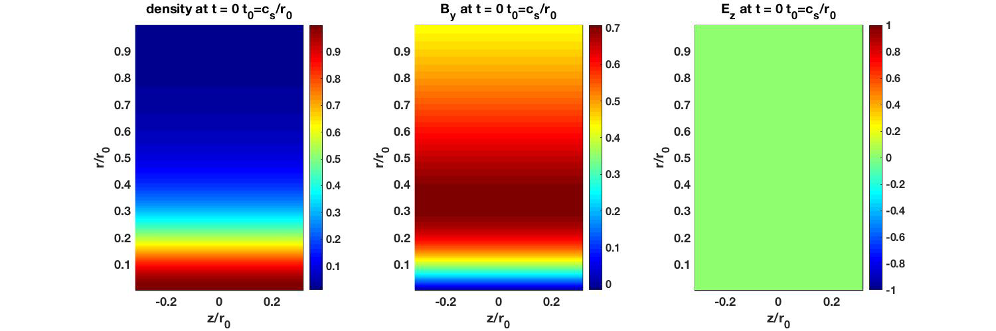
Hall MHD (JxB and gradP) (Li/r0=5.0e-3)

Slide 3
Hall MHD (JxB and gradP) (Li/r0=1.0e-1)

Slide 4
Drift-Ideal MHD model

Slide 5

Sausage mode can be stabilized with increasing adiabatic coefficient Ideal MHD with Bennett profiles
γ=5/3
γ=2.1

Slide 6
unstable sausage mode drifts with electrons in drift-ideal model (Hall effect)
Ideal MHD γ=5/3
drift-ideal γ =5/3 L_{i}/r₀=5.0e-3

Slide 7
Increasing gamma stabilizes m=0 in ideal MHD Increasing gamma in drift-ideal stabilizes ideal mode, but destabilizes entropy mode
Ideal MHD γ=2.1
drift-ideal γ =2.1 L_{i}/r₀=5.0e-3

Slide 8
Entropy mode can be stabilized with strong thermalization such that Te≈Ti
drift-ideal γ =2.1 L_{i}/r₀=5.0e-3
NuT= 100
drift-ideal γ =2.1 L_{i}/r₀=5.0e-3
NuT = 0

Slide 9
Entropy mode grows slower than ideal mode
Increasing gamma larger than 2 stabilizes ideal mode, but destabilizes entropy mode
Entropy mode can be stabilized by driving electron and ion temperatures to be the same
Thermalization has no significant affect on ideal mode
Seeded mode: kR=10, krhoi = 0.1

